Slide 1
Introduction to Arduinos
By Crystal Hess

Slide 2
Learning Goals
What is an embedded system?
What is an Arduino?
How to make an LED blink on an Arduino
How to make an LED fade on an Arduino
Vocab: Arduino board, bread board, male-male wires, LEDs, compiling a program, uploading a program, digital vs analog

Slide 3
What is an Embedded System?
An embedded system is a computer system with a dedicated function within a larger mechanical or electrical system, often with real-time computing constraints.
It is embedded as part of a complete device often including hardware and mechanical parts.
Embedded systems control many devices in common use today.

Slide 4
What is an Arduino?
A small computer on a single chip
containing a processor, memory, and input/output
Typically "embedded" inside some device that it controls
Small and low cost

Slide 6
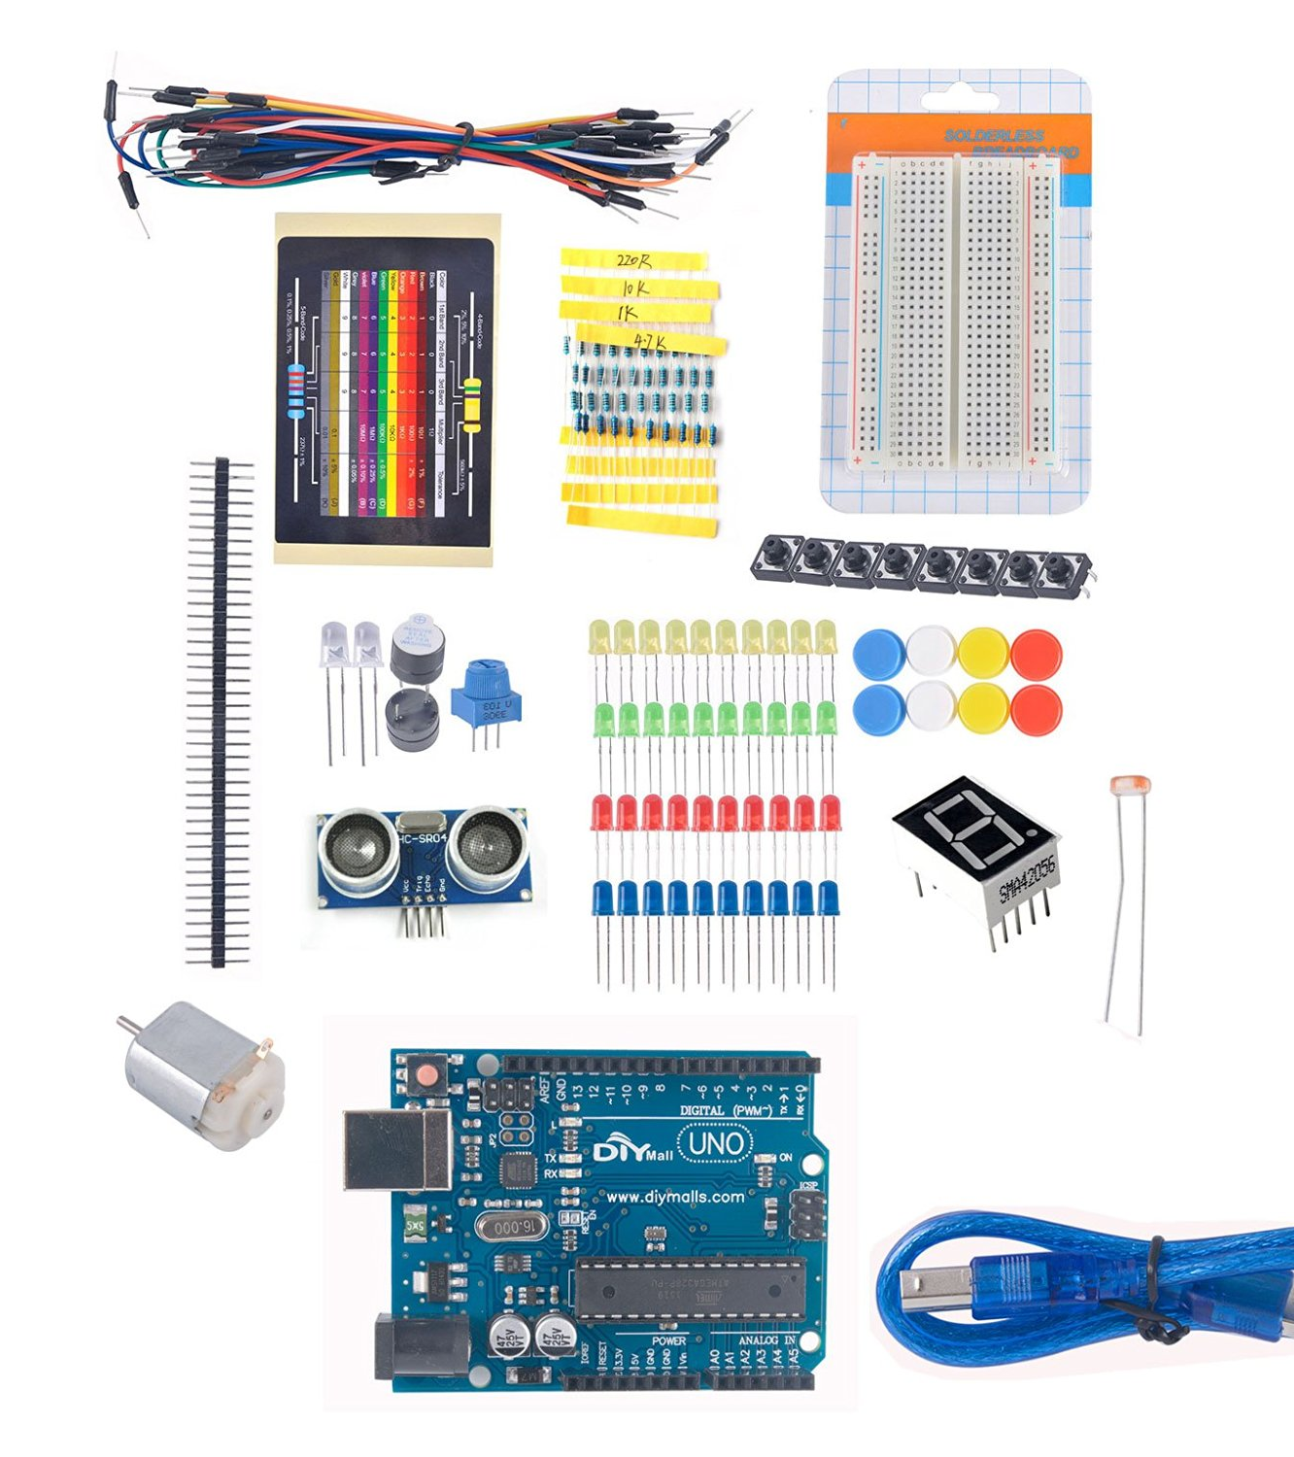
Get your own
Hardware ~ around $20
Diymall UNO R3 Beginner Learning Kit for Arduino Starter Kits LED Set Xmas Gift Experiment by DIYmall
https://amzn.com/B017SCDJ64
Software ~ free
Download at arduino.cc

Slide 7
Blink Example

Slide 8
Example: Blink
Hardware
Arduino board
Bread board
2 male-male wires (color doesn’t matter)
1 LED (color doesn’t matter)
Software
Launch the Arduino IDE
Select your board
Select your serial port (don’t forget this!)
Open the example Basics → Blink
Upload the program

Slide 9
Play with the Code
What does digitalWrite do? delay?
What happens if you put // (forward slash, forward slash) in front of a line of code?
What happens if you change pinMode(LED_BUILTIN, OUTPUT) to say pinMode(13,OUTPUT)? What about pinMode(9,OUTPUT)?
Can you make the LED blink using pin 9?
Challenges
Make your program light up multiple LEDs at the same time.
Make your program light up multiple LEDs at different times.
Make your program light up to the tune of “Jingle Bells”

Slide 10
Resistors
Learn how to change the brightness of an LED by using different values of resistor.
https://learn.adafruit.com/adafruit-arduino-lesson-2-leds/overview

Slide 11
Resistor Color Code
The resistor color code works like this, for resistors like this with three colored stripes and then a gold stripe at one end. Each color has a number, as follows:
Black 0
Brown 1
Red 2
Orange 3
Yellow 4
Green 5
Blue 6
Purple 7
Gray 8
White 9
The first two stripes are the first two digits of the value. The next stripe is the number of zeros that need to come after the first two digits.
A resistor with stripes brown, black, orange is 10 and three zeros so 10,000 Ω in other words 10 kΩ.

Slide 12
Fade Example

Slide 13
Example: Fade
Hardware
Use the same hardware setup as the Blink example
Software
Open the example Basics → Fade
Upload the program

Slide 14
Play with the Code
What happens if you try to use pin 13 instead of 9? Test out other pins. Which work and which don’t?
What does changing the fadeAmount do? (Try 1, 10, 25, 255) Why?
Try this out:
Open Tools → Serial Monitor
Add Serial.begin(9600) to the end of the setup()
Add Serial.println(brightness) at the top of the loop()
Load the program and observe what happens
What does if (brightness <= 0 || brightness >= 255) do?
What does fadeAmount = -fadeAmount; do?
Challenge
Make the LED fade out very slowly and then not come back on.

